Slide 1
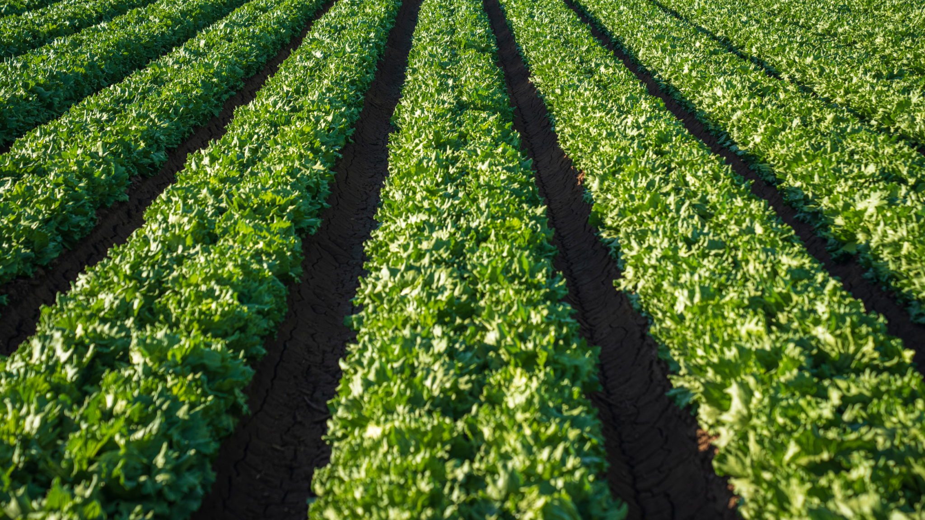
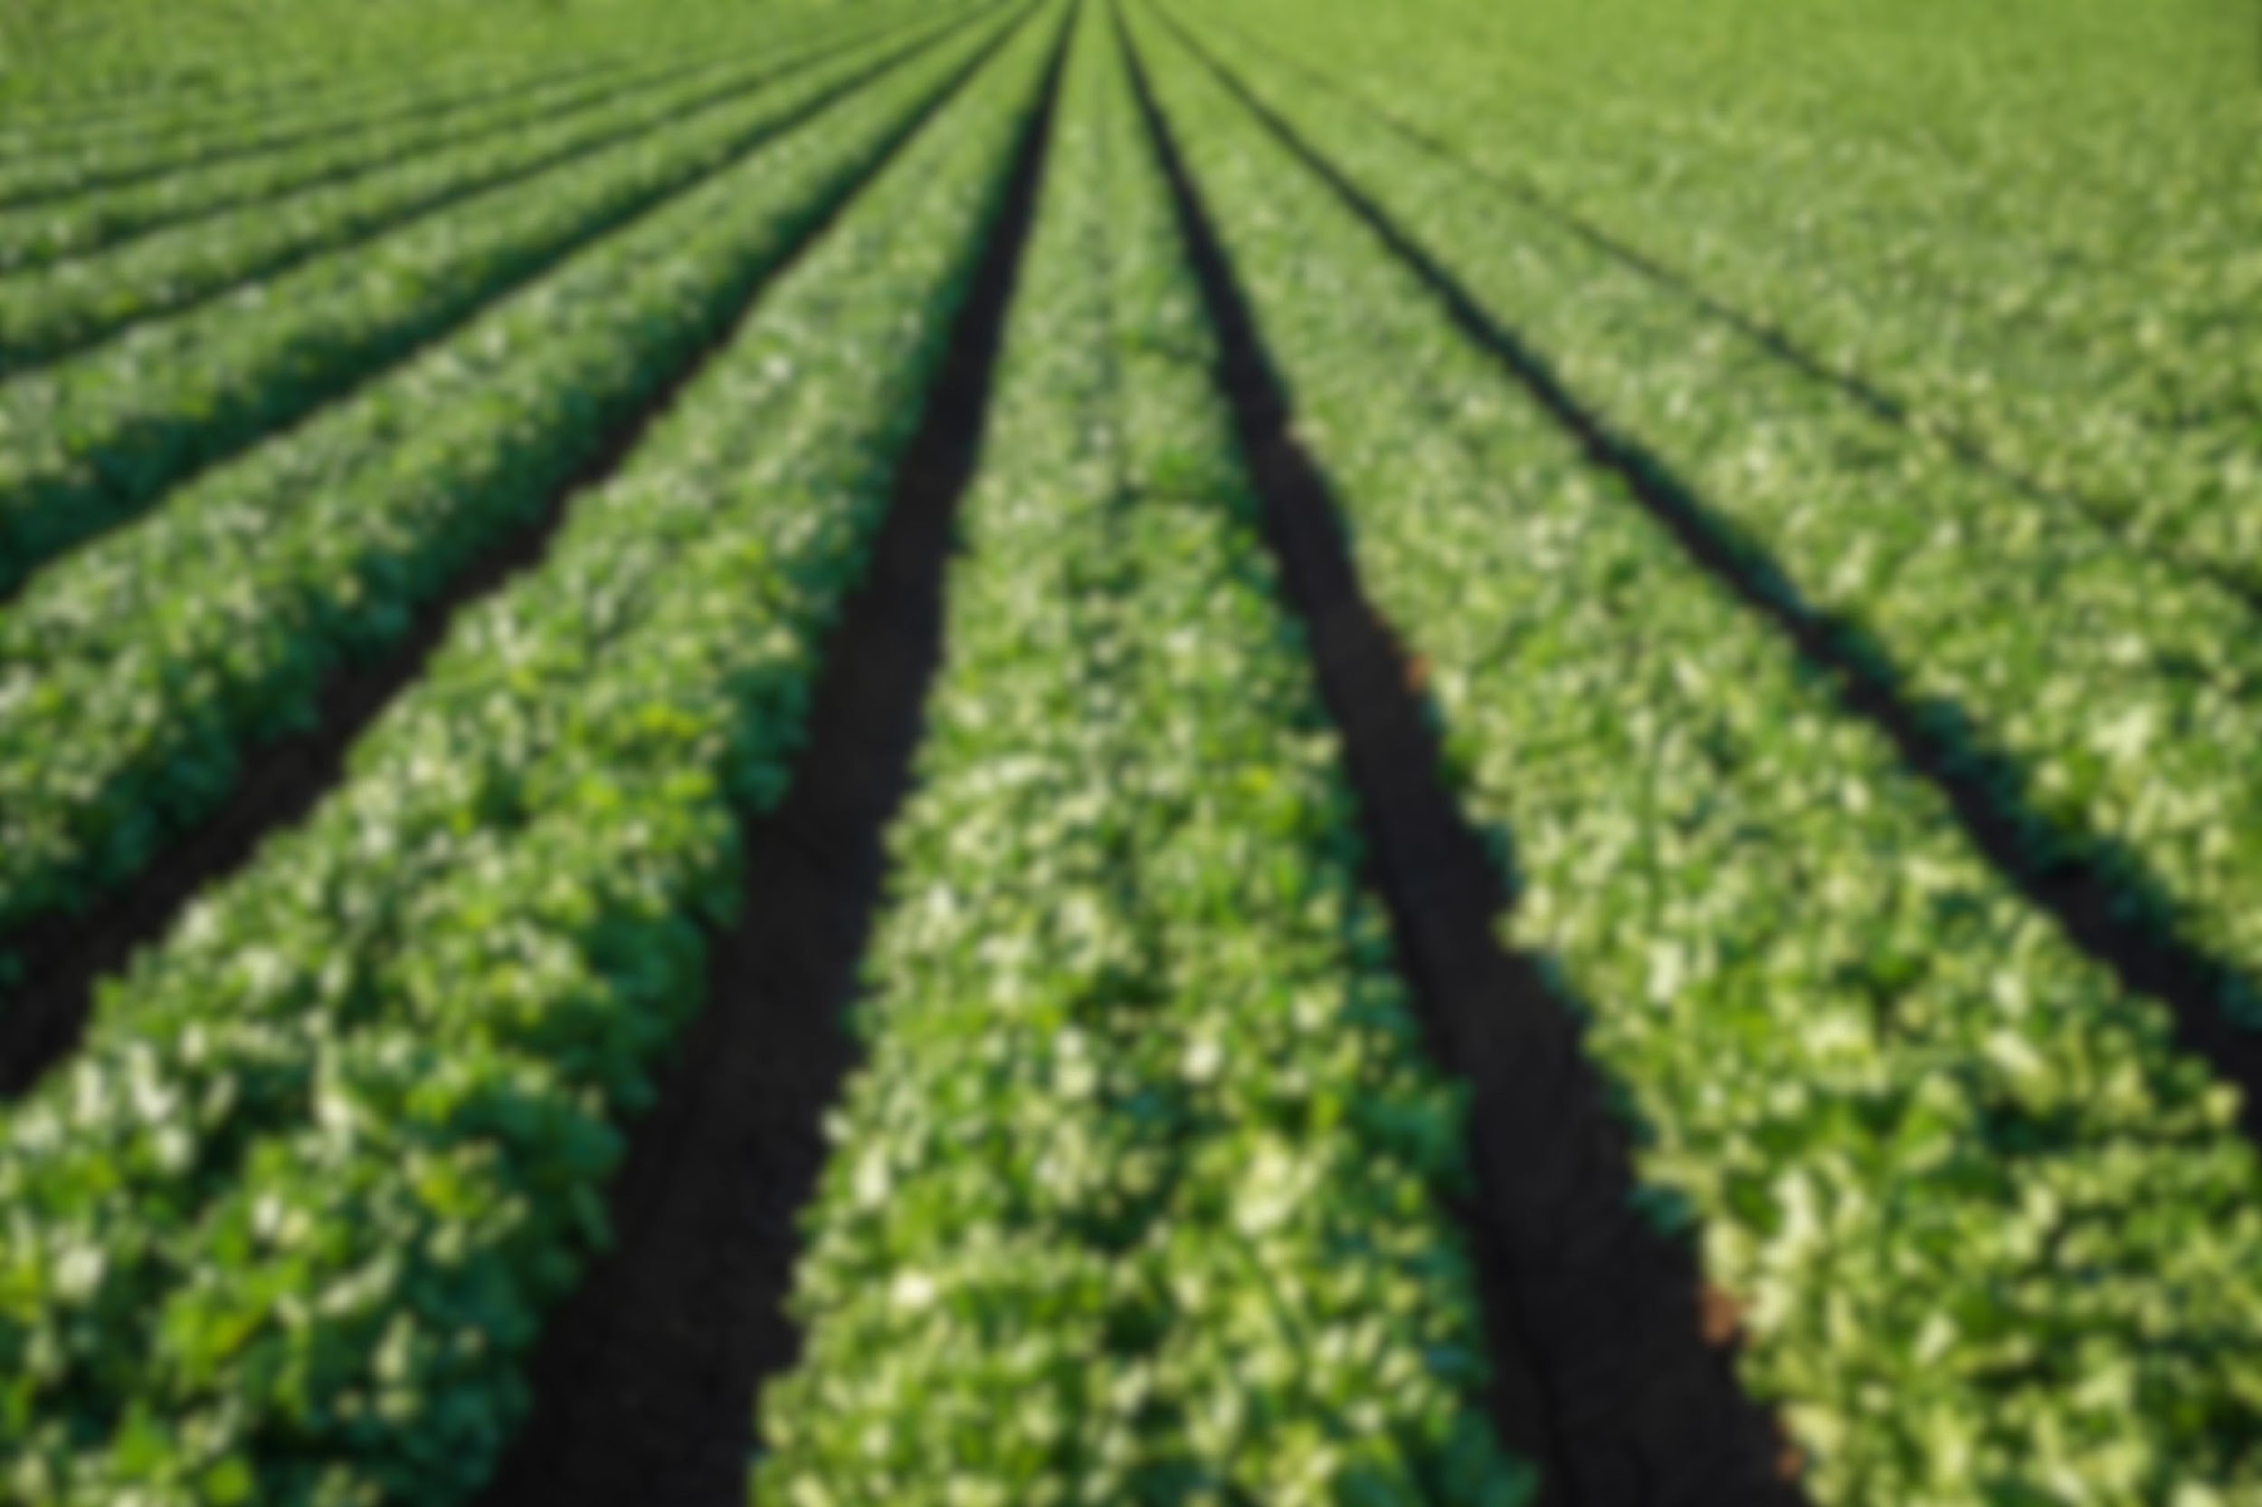
Team LoLLogic
Smart Agriculture.

Slide 2
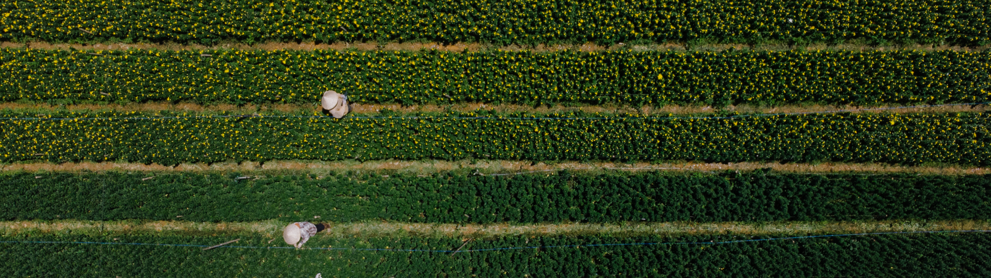
Our Solution
Revolutionize
Innovate
Affordability
AI-driven hardware in agriculture, like AIML in PCB design, uses data acquisition, deep learning, and PCB design to enhance precision farming, optimizing resources and boosting productivity through automation and advanced analytics.
This innovative agriculture project utilizes IoT technology to optimize farming practices, helping farmers increase productivity, improve yield quality, and boost profitability through weather analytics, plant monitoring, etc
This innovative agriculture project uses IoT technology to optimize farming practices, helping farmers increase productivity, improve yield quality, and boost profitability using analytics,.

Slide 3
Table Of Contents
Introduction
Project Overview
ML Models
PCB Implementations
Analysis
Future Scope

Slide 4
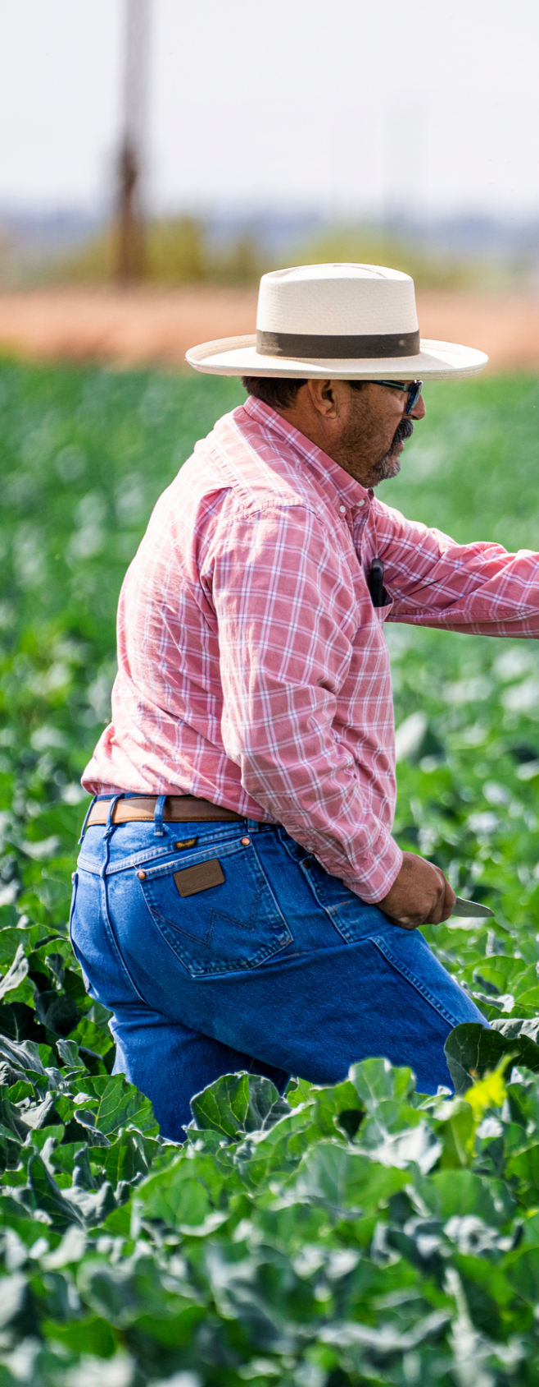
1.
Introduction
In the current farming landscape, traditional methods heavily rely on physical labor or basic tools. However, with the rapid integration of IoT and AIML technologies, there is a significant shift towards enhancing efficiency and simplifying tasks. Our primary objective in this competition was to introduce beginner-friendly yet innovative technology into the daily routines of farmers, aiming to reduce labor-intensive processes and improve overall productivity.

Slide 5
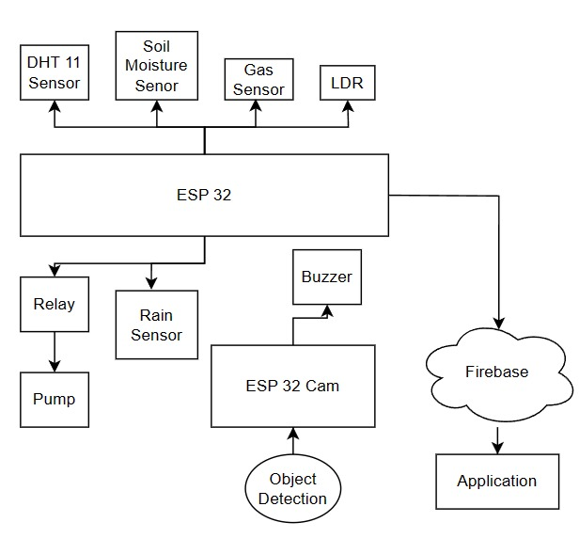
2.
Project Overview
The project involves connecting sensors measuring plant growth parameters to an ESP32 microcontroller for data processing and uploading to Firebase, allowing users to access the data through a website or app. Additionally, Object Detection and Rainforest Regression models are utilized to forecast plant yield and water consumption, demonstrating the project's use of IoT technology to improve agricultural practices and offer valuable predictive insights to farmers.

Slide 6
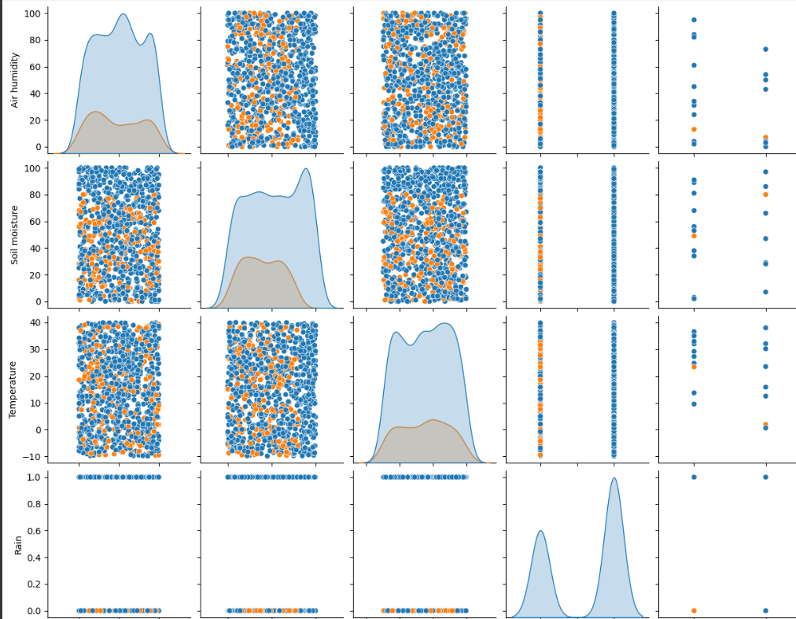
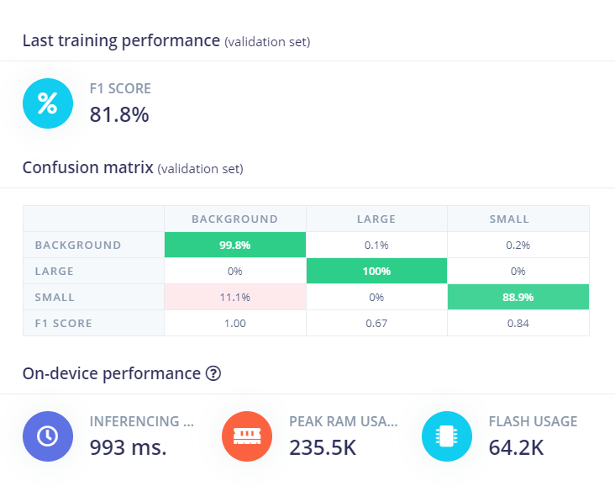
1.
ML Models :
Software used: Google Colab
Software used: Edge Impulse
WaterSense Automation Model
Plant Size Estimation

Slide 7
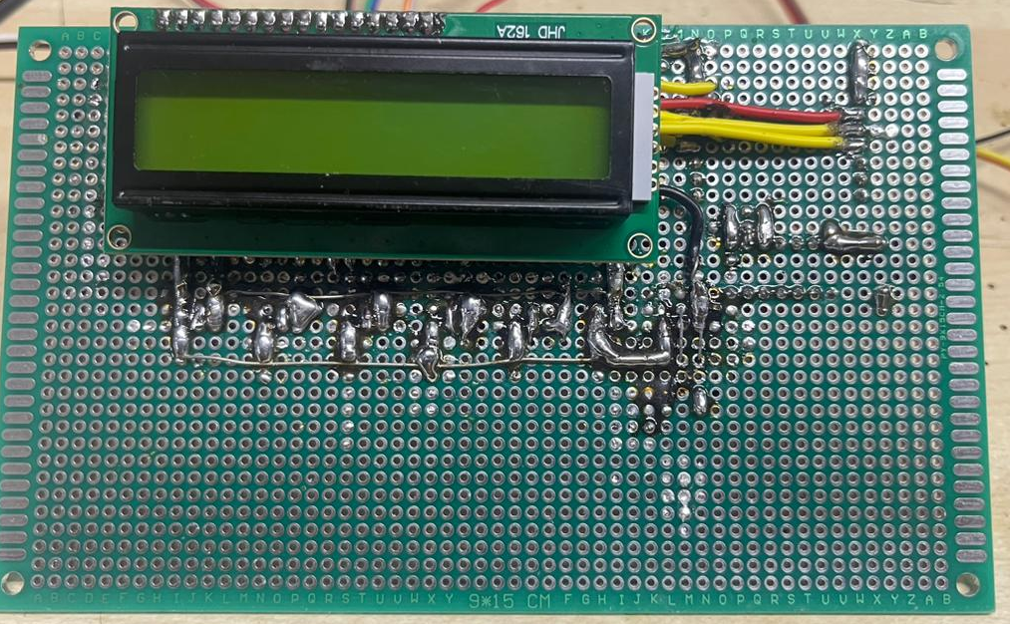
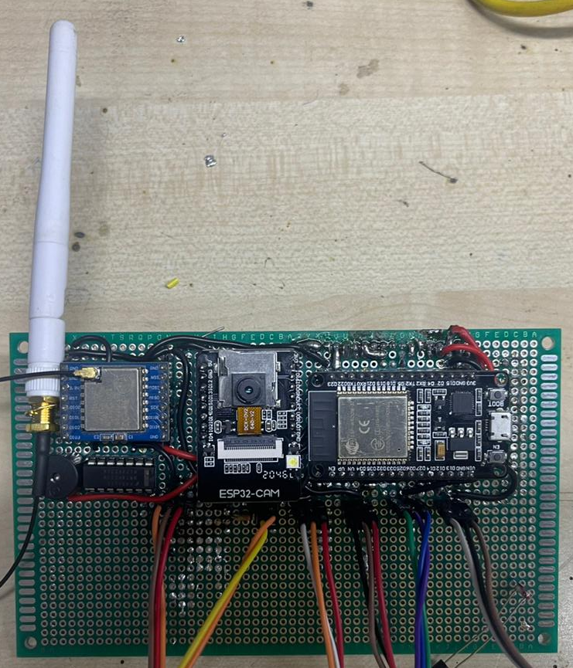
PCB Implementation
What we do?
Our Implementaion of the Hardware on Zero PCB using Soldering and using both sides of pcb

Slide 8
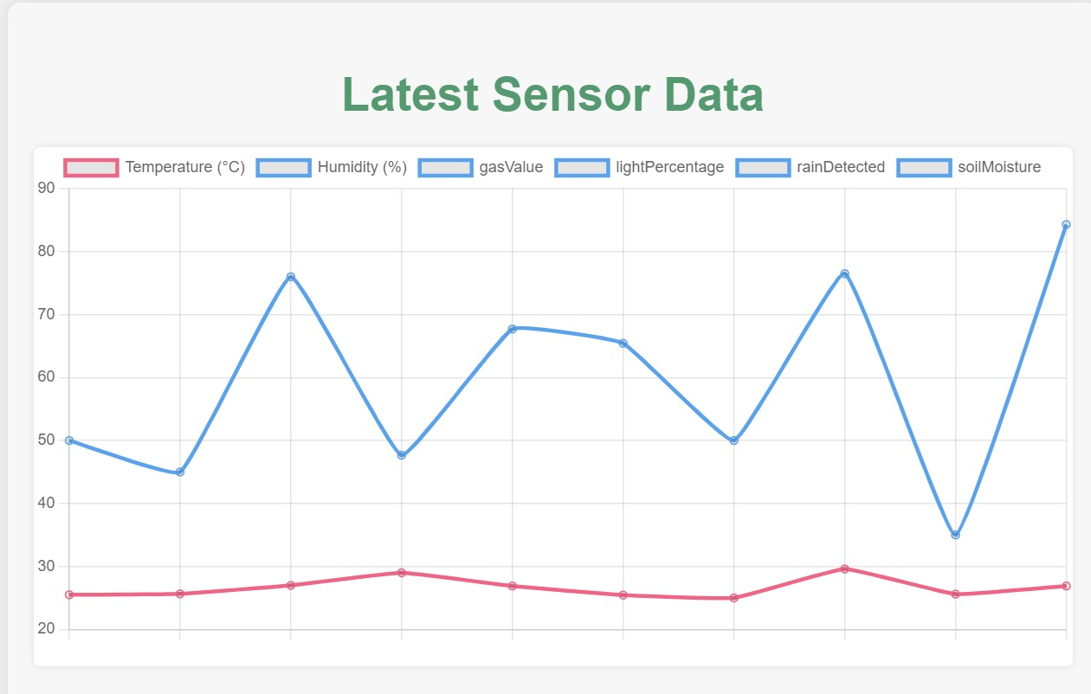
Data Visualization From Cloud and App

